Slide 1
Flow of performing Regression is like this:
Identify the targets
Check the targets
Build the correct Target
Run all targets
Collect all results and log
Analyse

Slide 2
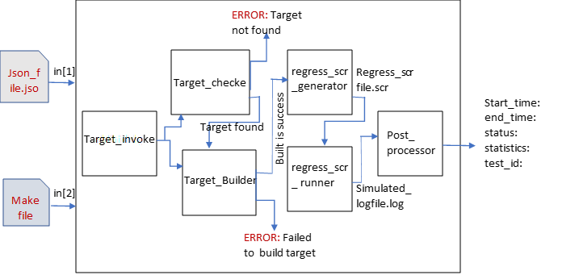
Fig1: System Block Diagram which performs regression

Slide 3
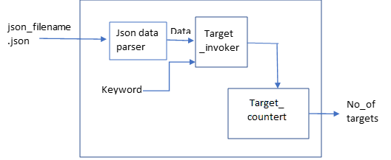
Target Identifier Block:
Target_identifier: Reading the data present in the json_file and counting the number of targets found in the json file by using the keyword “target_name”.

Slide 4
Target Identifier Block:
Target_identifier: Reading the data present in the json_file and counting the number of targets found in the json file by using the keyword “target_name”.

Slide 5
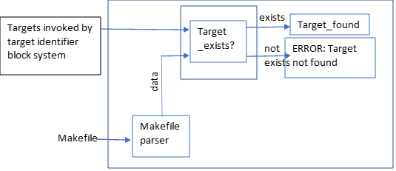
Target Checker Block:
Target_checker: The target identified in the json file must have the same targets in the makefile. Just need to check the targets in the makefile is same as the targets found inside json file.

Slide 6
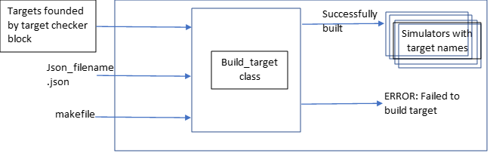
Target Builder Block:
Target Builder: The build target block will obtain the simulated file or the executable file with the name of targets. The target build is successful when there will be a file exists with the same name.

Slide 7
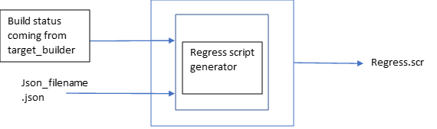
Regress script generator:
Regress Script Generator: This block will invoke each target in the json file by creating and writing in the form of commands to run that each line in the regress.scr file

Slide 8
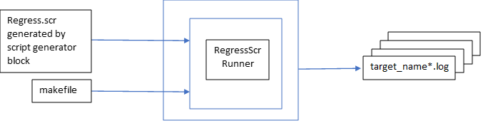
Regress script runner:
Regress Script Runner: This block will call the makefile with the target name: run_regress_scr, this will automatically run all the commands and each target simulation will outputs a log file with the <target_name.log>

Slide 9
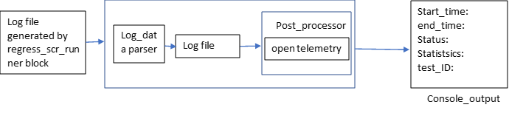
Post Processor:
Post Processor: This block will read the log file data and extract the information like start_time, end_time, status, statistics, with respective test_id... using opentelemetry api.

Slide 10
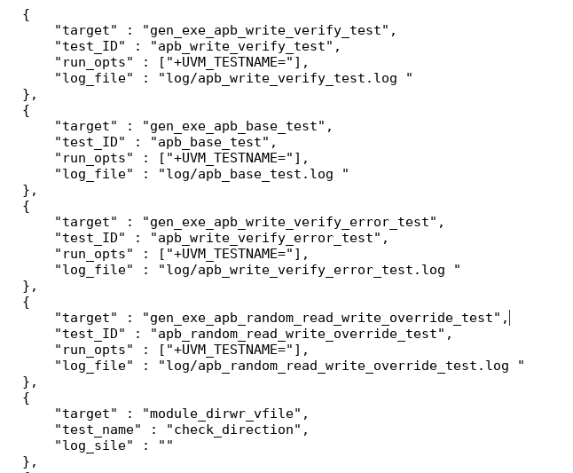
Json file content
Generated Regress script content

Slide 11
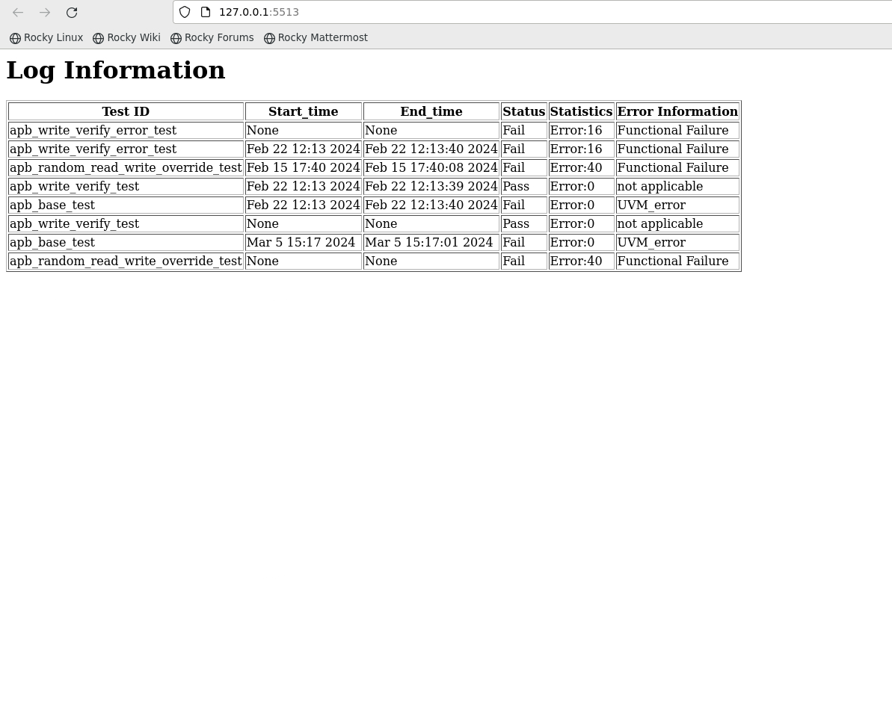
Dashboard

Slide 12

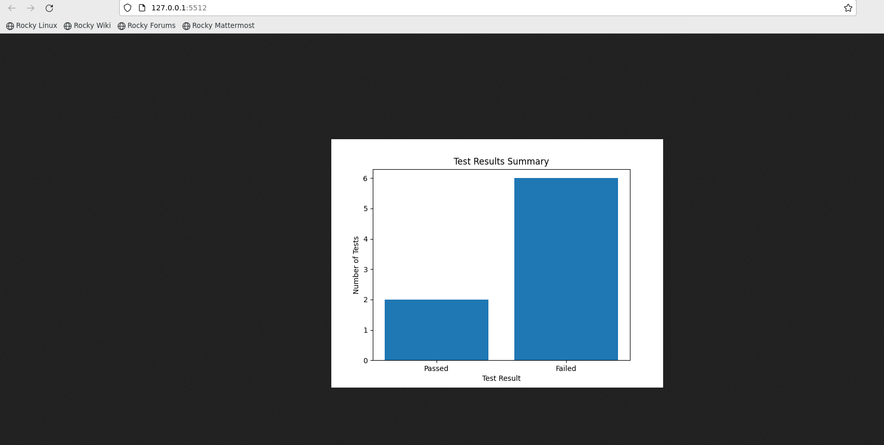
Sending mail to the given mail-id with excel file attachment
Graph showing total number of test cases passed and failed

Slide 13
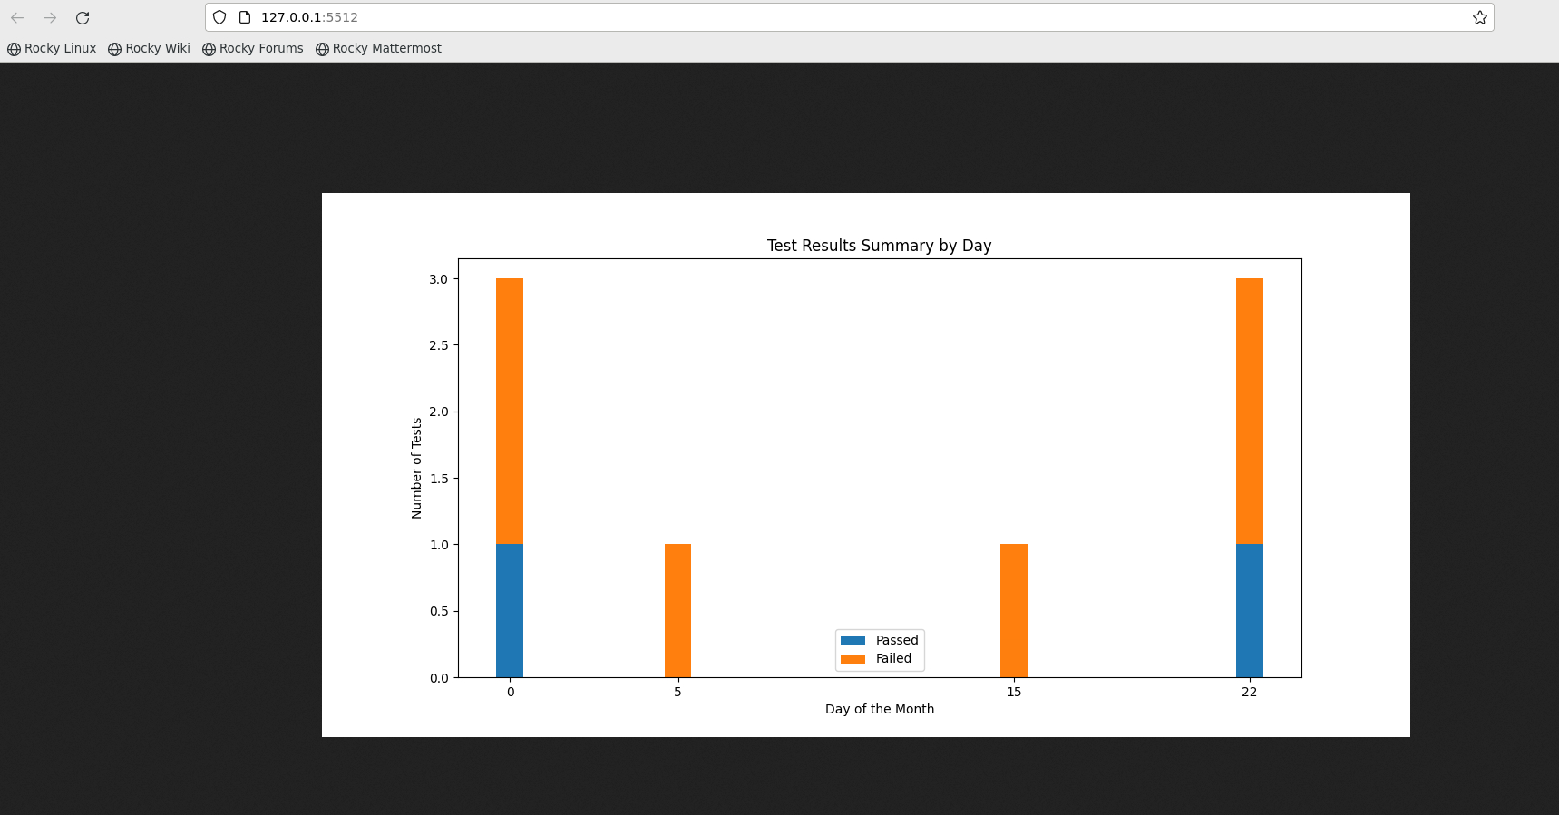
Graph showing test-cases pass and fail in day wise

Slide 14
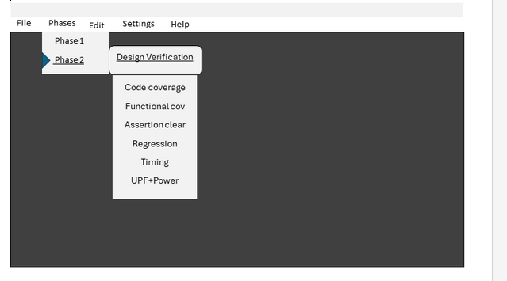
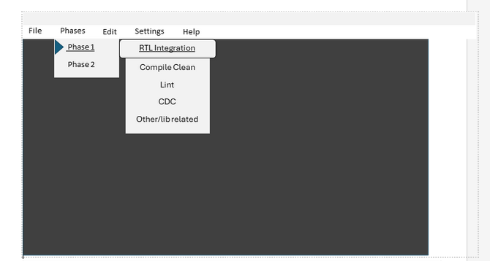
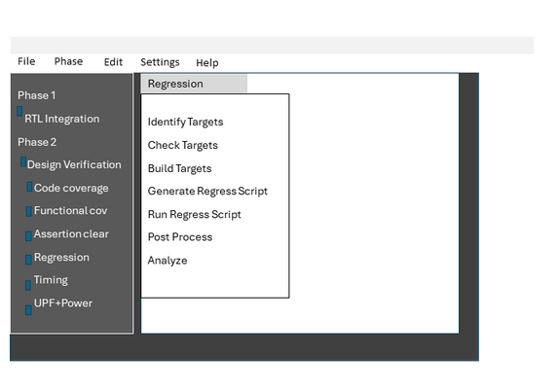
Future Work:
Building automation application
Pictorial view of GUI:

Slide 15

Timeline:

